Slide 1


VAYCAME
Objectives
Reporters
Boarding
Lisbon, Portugal
Sign In
En
WELCOME !
Explore
LISBON, PORTUGAL
Dr. Hala Fendi
Miho Terahata

Slide 2
Award winning tour for abc company

Slide 3
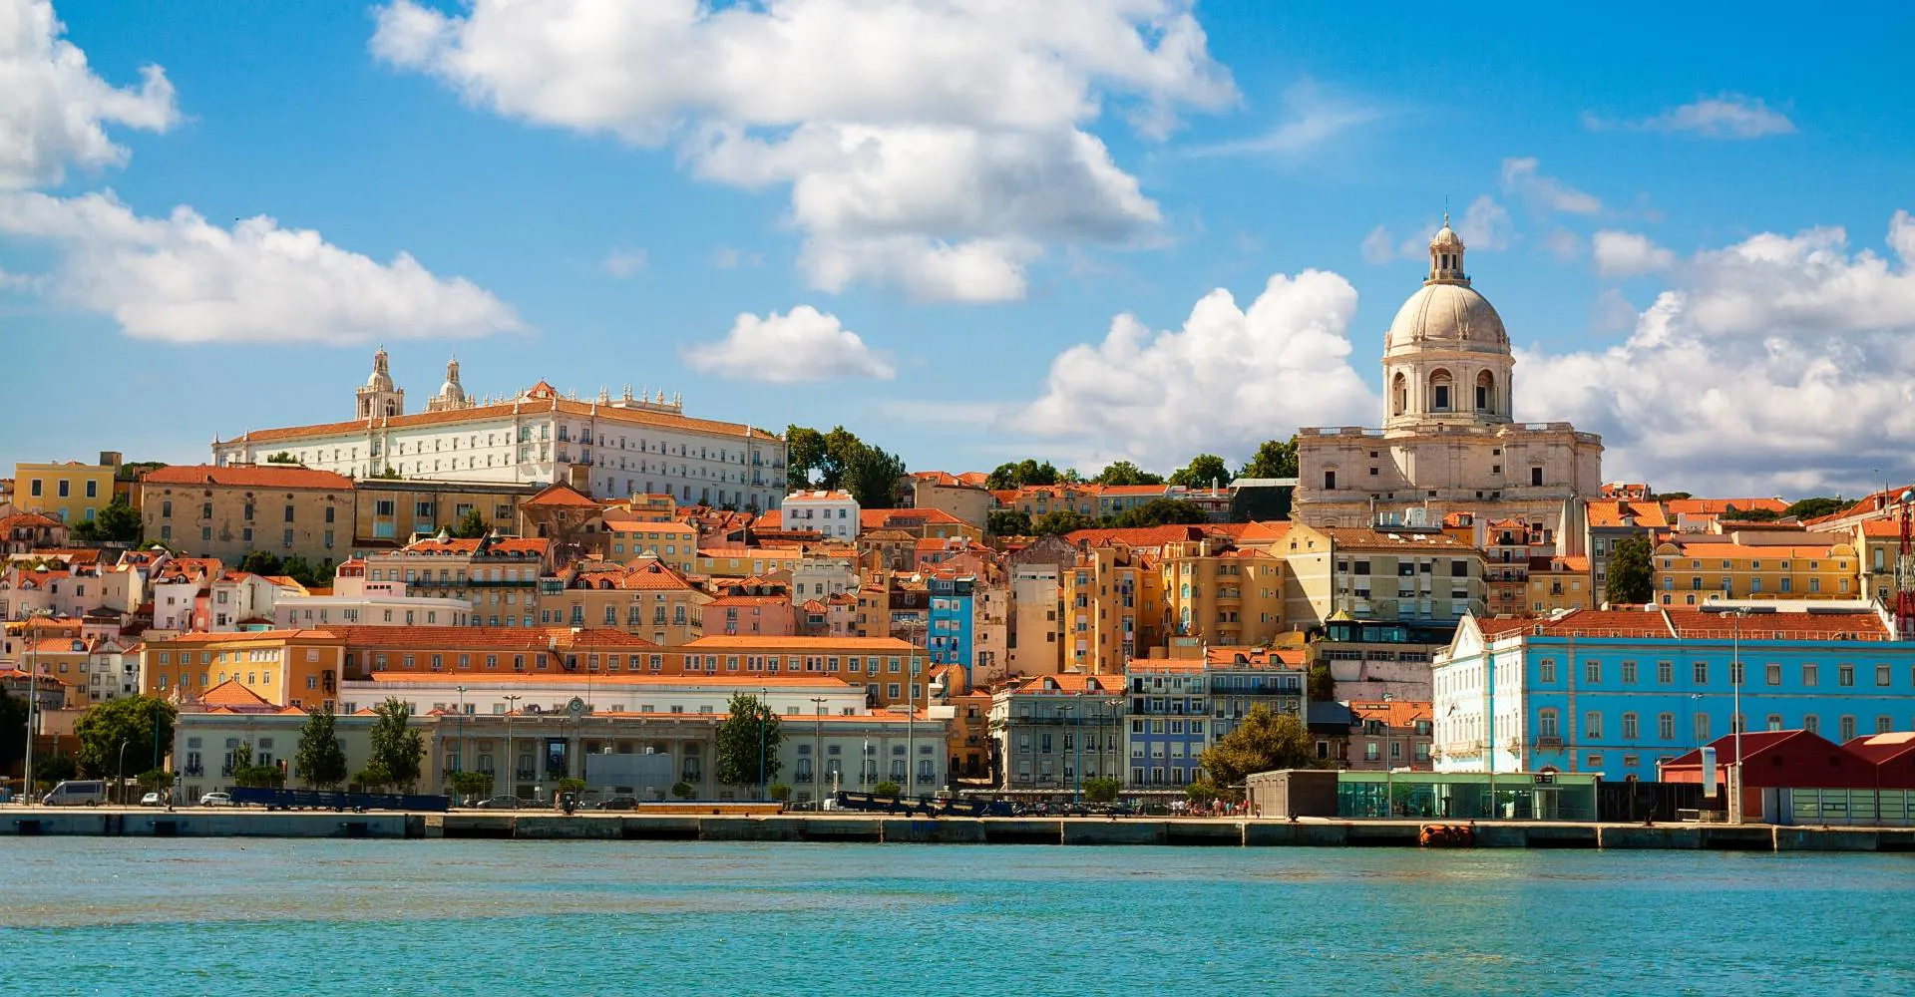







VAYCAME
Objectives
Reporters
Boarding
Lisbon, Portugal
Sign In
En
Air Canada
||||||||||||||||||||||
Air Canada
Table of Contents
Flight
AC116 10MAY24
Boarding Time: 03:00PM
Initiating the Project
SUITE GATE TERMINAL
3D 134 C
Project Charter (Deliverable, Stakeholders, Milestone)
Scope Management and Statement
ETNo. 235587419867226
Lisbon Itinerary for 8 DAYS
Work Breakdown Structure (WBS)
YOU ARE INVITED TO THE AIR CANADA LOUNGE
Risk Management
PLEASE BOARD EARLY GATE CLOSES 10MINS BEFORE THE FLIGHT
Cost Management
Gantt Chart
References
Notes:
The ticket section on the right side is just a design for the theme of the PowerPoint. It is up to you if you would like to delete that or change the text. But I suggest to keep it as it is and consider it as part of the design of your slide hehe~ -PRTN Slides

Slide 4


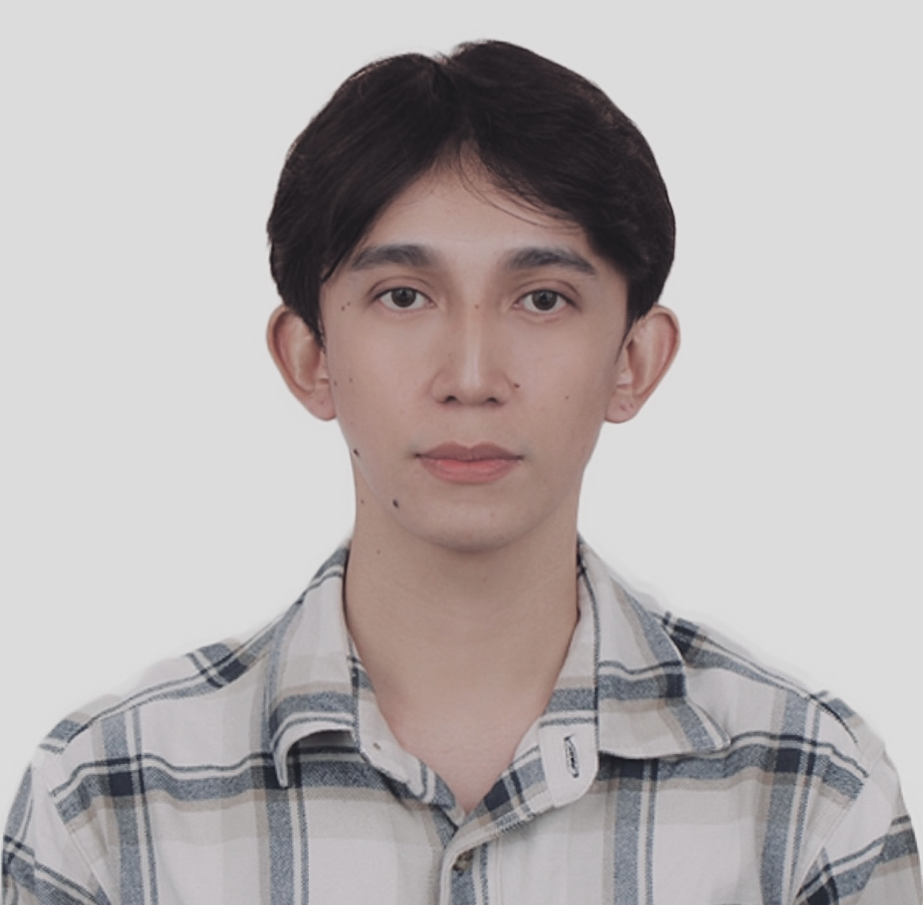

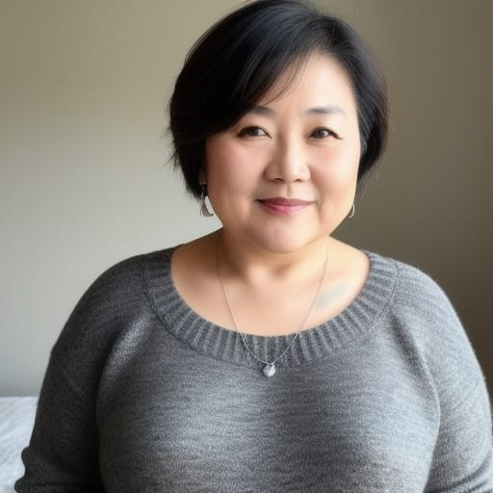
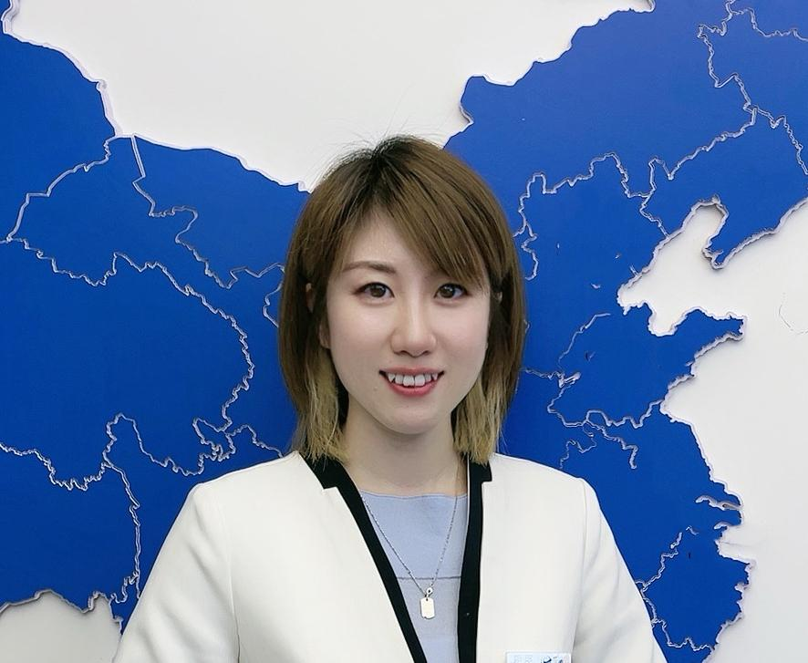


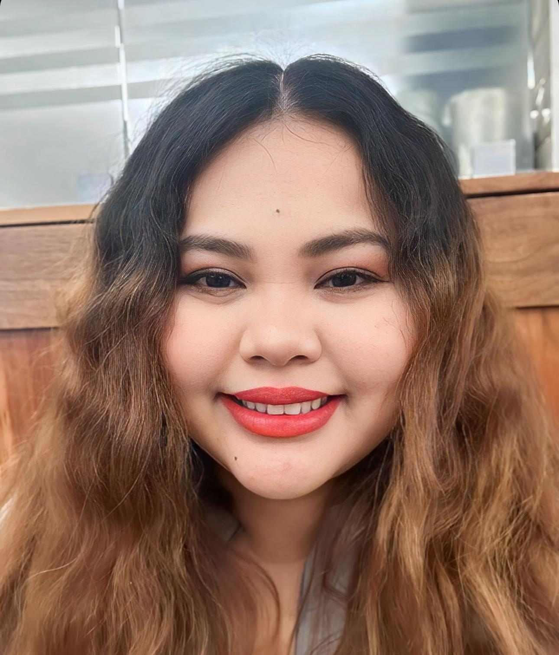
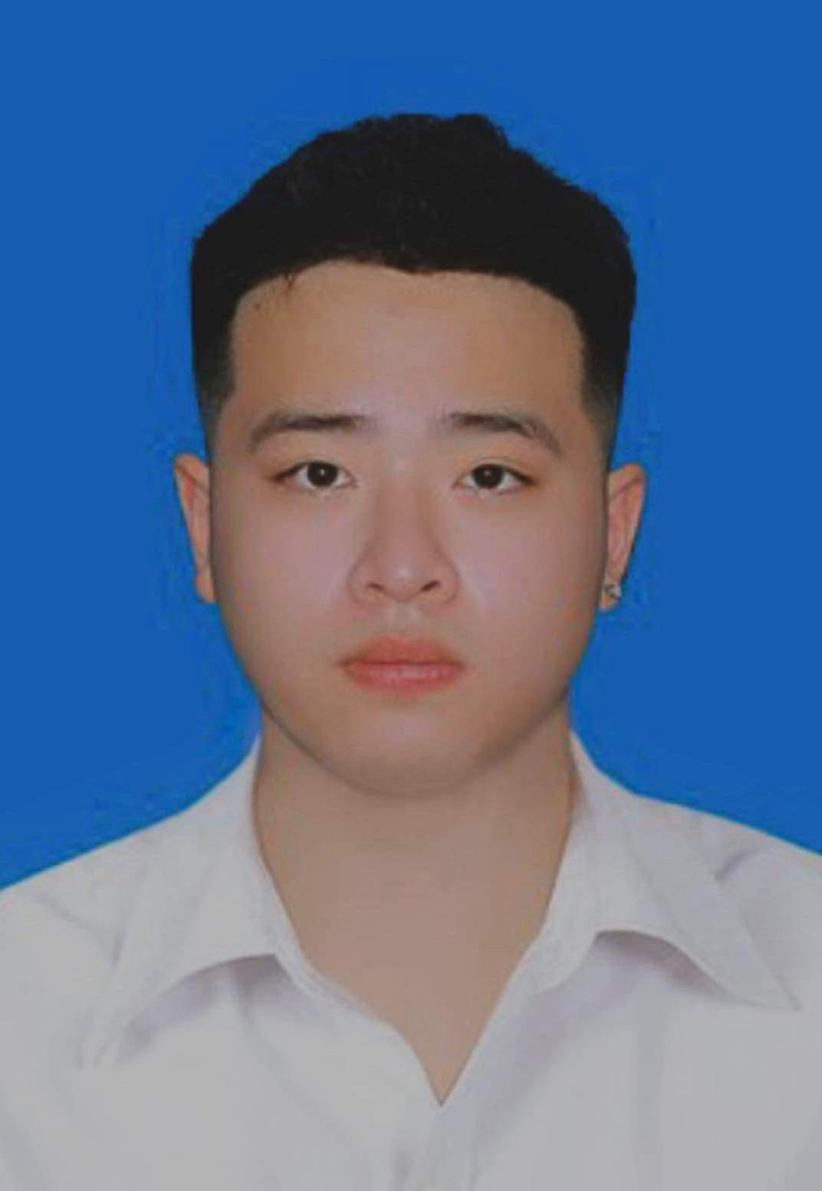
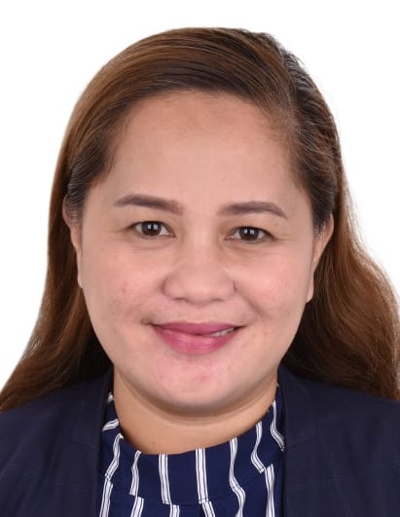

VAYCAME
Objectives
Reporters
Boarding
Lisbon, Portugal
Sign In
En
Almost There…
Reporters
flag
REPUBLIC OF YOUR OWN STATE HERE
flag
flag
REPUBLIC OF YOUR OWN STATE HERE
flag
flag
REPUBLIC OF YOUR OWN STATE HERE
flag
NAME:
NAME:
NAME:
Christan Rey T. Llanto
Miho Terahata
Yang Yang
AGE:
AGE:
AGE:
24 Years Old
49 Years Old
37 Years Old
flag
REPUBLIC OF YOUR OWN STATE HERE
flag
flag
REPUBLIC OF YOUR OWN STATE HERE
flag
flag
REPUBLIC OF YOUR OWN STATE HERE
flag
NAME:
NAME:
NAME:
Ann Carmel
Phan Tuan Dat
Evelyn Robles
AGE:
AGE:
AGE:
30 Years Old
20 Years Old
45 Years Old
Notes:
The ticket section on the right side is just a design for the theme of the PowerPoint. It is up to you if you would like to delete that or change the text. But I suggest to keep it as it is and consider it as part of the design of your slide hehe~ -PRTN Slides

Slide 5
VAYCAME
Objectives
Reporters
Boarding
Lisbon, Portugal
Sign In
En
OBJECTIVE (MISSION)
Project Charter
Motivate ABC Company’s employees.
Promote valuable interpersonal networking.
Prioritize the well-being of top management.
Create a more positive work environment
Strengthen the commitment to excellence demonstrated by top managers
Set a standard for leadership and increase motivation among employees.

Slide 6
VAYCAME
Objectives
Reporters
Boarding
Lisbon, Portugal
Sign In
En
DELIVERABLES
Project Charter
Finalized Itinerary
Accommodations and meals
Transportation
Guided Tours
Budget management
Emergency support services
Feedback analysis

Slide 7
VAYCAME
Objectives
Reporters
Boarding
Lisbon, Portugal
Sign In
En
STAKEHOLDERS
ABC Company(senior management, HR, Award winners, spouses)
VAYCAME Travel (Project manager, PR, Team members, Finance, Marketing)
Locals ( guides, Hotels, Restaurants, Local transportation, entertainment)
Regulatory Bodies ( Authorities in Canada and Portugal)
Project Charter

Slide 8
VAYCAME
Objectives
Reporters
Boarding
Lisbon, Portugal
Sign In
En
MILESTONES
Project Kickoff-May 10, 2024.
Client Approval-May 14
Booking Confirmation-May 23
Finalize Itinerary-May 27
Pre-tour Briefing-May 29
Execution-June 1
Mid-tour review-June 4
Tour completion-June 8
Post-tour Feedback-June 10
Close Project-June 12
Project Charter

Slide 9
VAYCAME
Objectives
Reporters
Boarding
Lisbon, Portugal
Sign In
En
CONSTRAINTS
Budget Limitation
Time Frame
Croup Size
Participant Preferences
ABC Co’s intention
Scope Management

Slide 10
VAYCAME
Objectives
Reporters
Boarding
Lisbon, Portugal
Sign In
En
INCLUSION
Double rooms for three pairs for 7 days
8 Breakfasts, 7 Lunches, 8 Dinners
All attractions
Local transportation with a guide for 7days
All tips during the group activities
All air tickets
Scope Management

Slide 11
VAYCAME
Objectives
Reporters
Boarding
Lisbon, Portugal
Sign In
En
Exclusion
Insurance
Personal expenses
Tips outside of the group activities
Local transportation during the free time
Local transportation to/from home to Vancouver Airport
Lunch during the free time
Scope Management

Slide 12
VAYCAME
Objectives
Reporters
Boarding
Lisbon, Portugal
Sign In
En
Acceptance Criteria
All services and arrangements have the industry quality standards
Positive feedback from the participants
Budget adherence without any compromising
Scope Management

Slide 13
VAYCAME
Objectives
Reporters
Boarding
Lisbon Portugal
Sign In
En
Constraints
Scope Statement
The total budget for the tour is C$36000.
All travel and activities are planned between June 1, 2024 and June 8, 2024
Any date change may affect the total cost of the travel.
The tour is designed for three couples.
Participants are responsible for valid passports and visas if necessary.
Participants are healthy and without any physical challenges.
Pre-notification is required for any allergies.

Slide 14
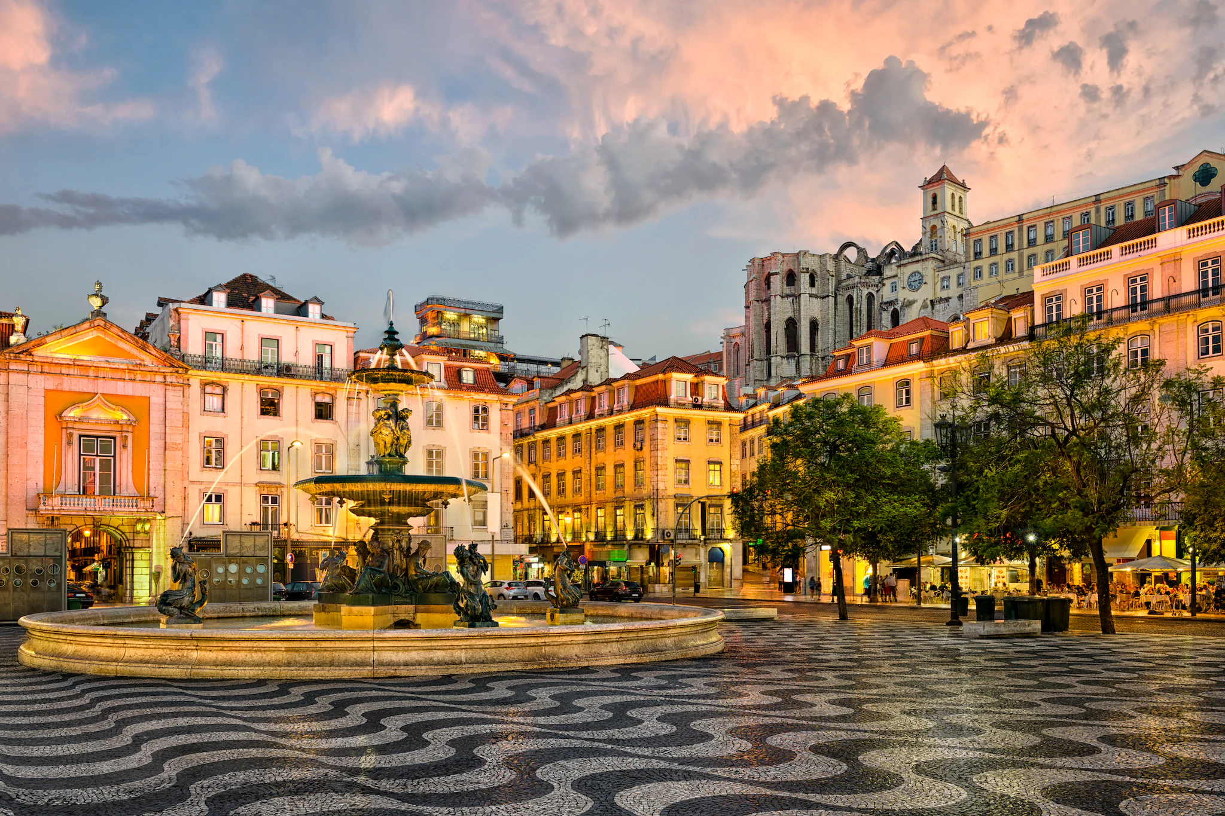

VAYCAME
Objectives
Reporters
Boarding
Lisbon Portugal
Sign In
En
ITINERARY
June 1 to 8, 2024
Notes:
Photo by Jake Irish on Unsplash

Slide 15






VAYCAME
Objectives
Reporters
Boarding
Lisbon, Portugal
Sign In
En
Hey There !
Ready to Board?
Explore Now
Air Canada
Hotel
Limousine
Road Trip
Passengers
Business Class
From
To
REPORT DATE
SUBJECT CODE
VANCOUVER
PORTUGAL
SAT, 01 JUN
PM - 401
BRITISH COLOMBIA
LISBON
Prev Next
Prev Next

Slide 16
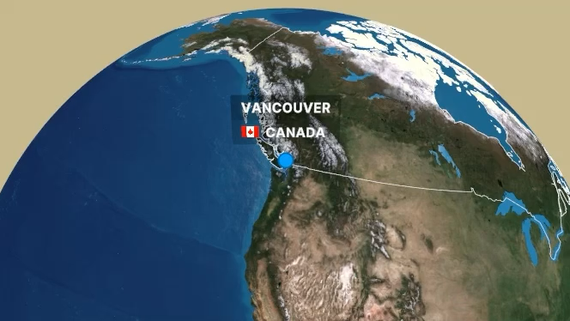
Air Canada
Flight
AC116 01JUNE24
Boarding Time: 01:50 PM
SUITE GATE TERMINAL
3D 134 C

Slide 17
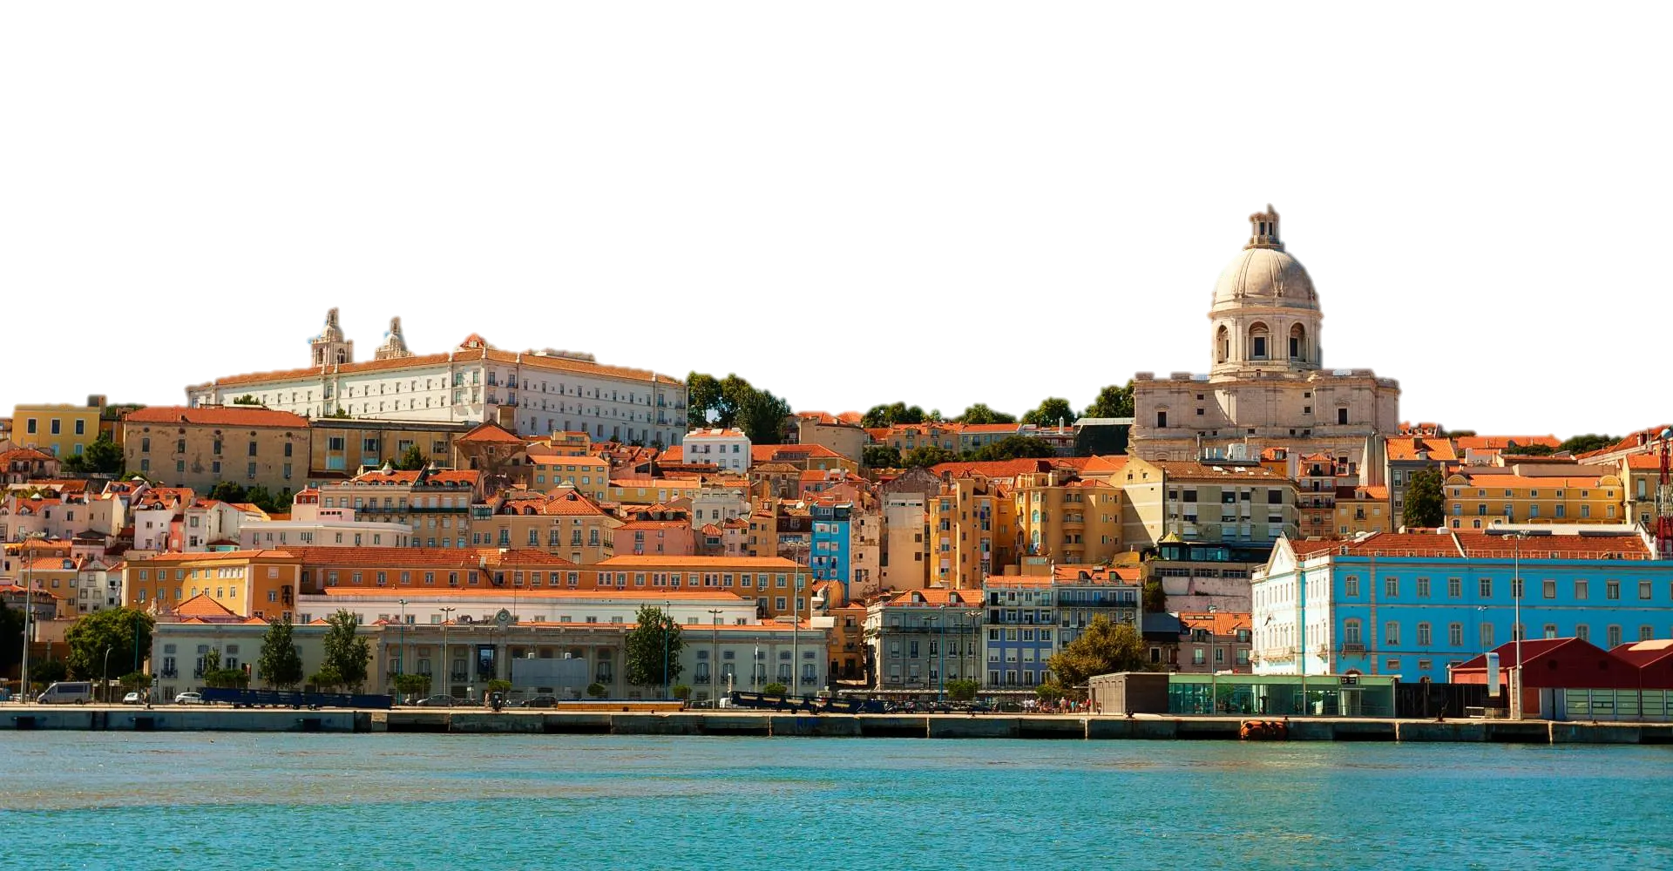
WELCOME TO LISBON
PORTUGAL

Slide 18
WELCOME TO LISBON
PORTUGAL

Slide 19
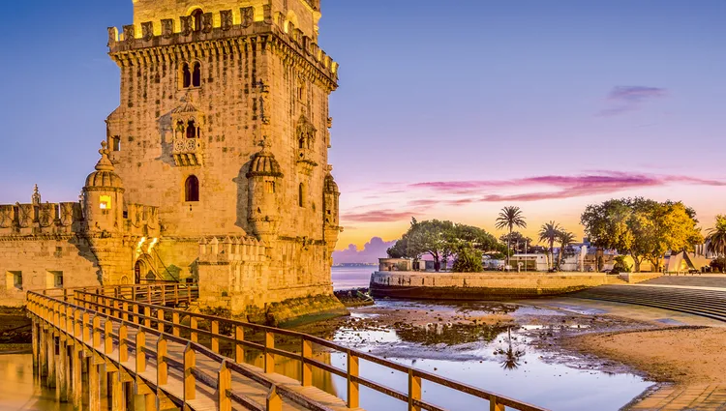
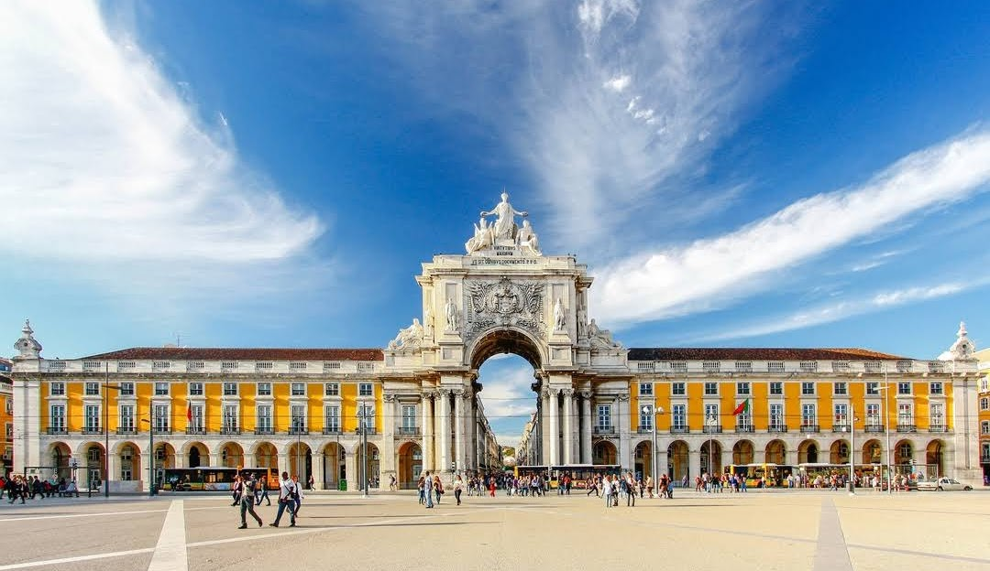
VAYCAME
Objectives
Reporters
Boarding
Search
Sign In
En
02
Lisbon, Protugal
HALF DAY TOUR OF LISBON
11:10 Arrive at Lisbon
13:30 Lunch at Minhota da Prata
14:30 Praca do comercio
18:30 Dinner at Solar 31-Peixe e Marisco

Slide 20
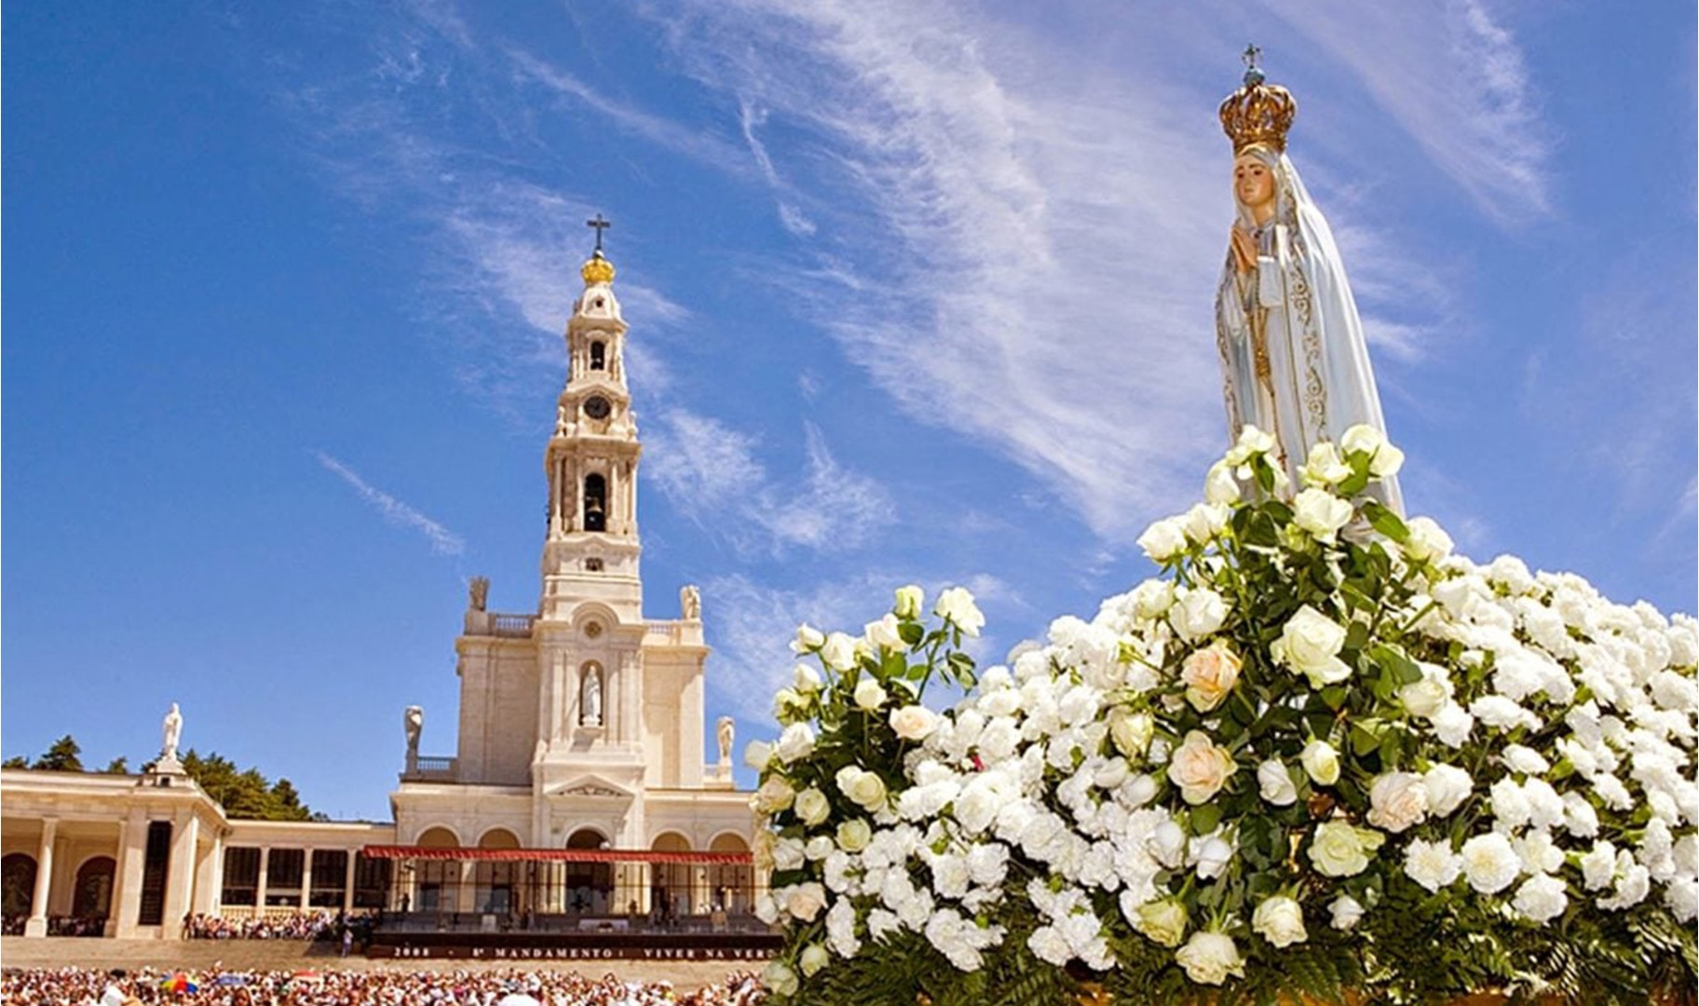
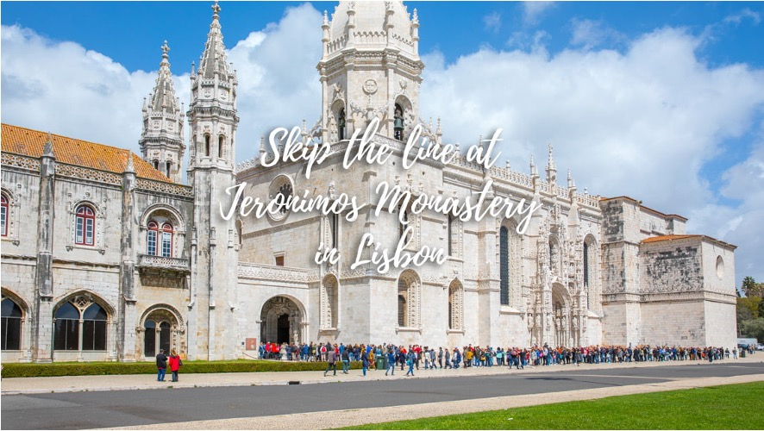
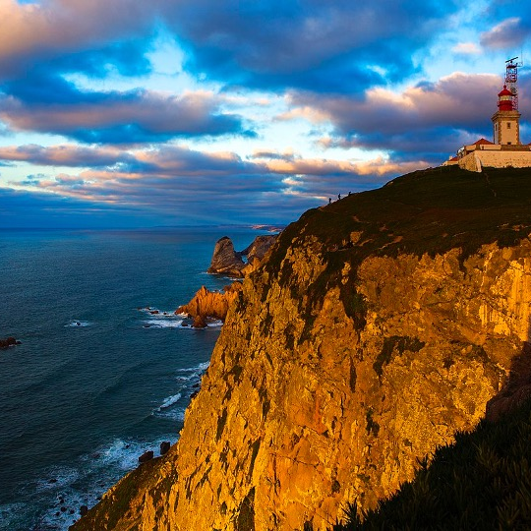
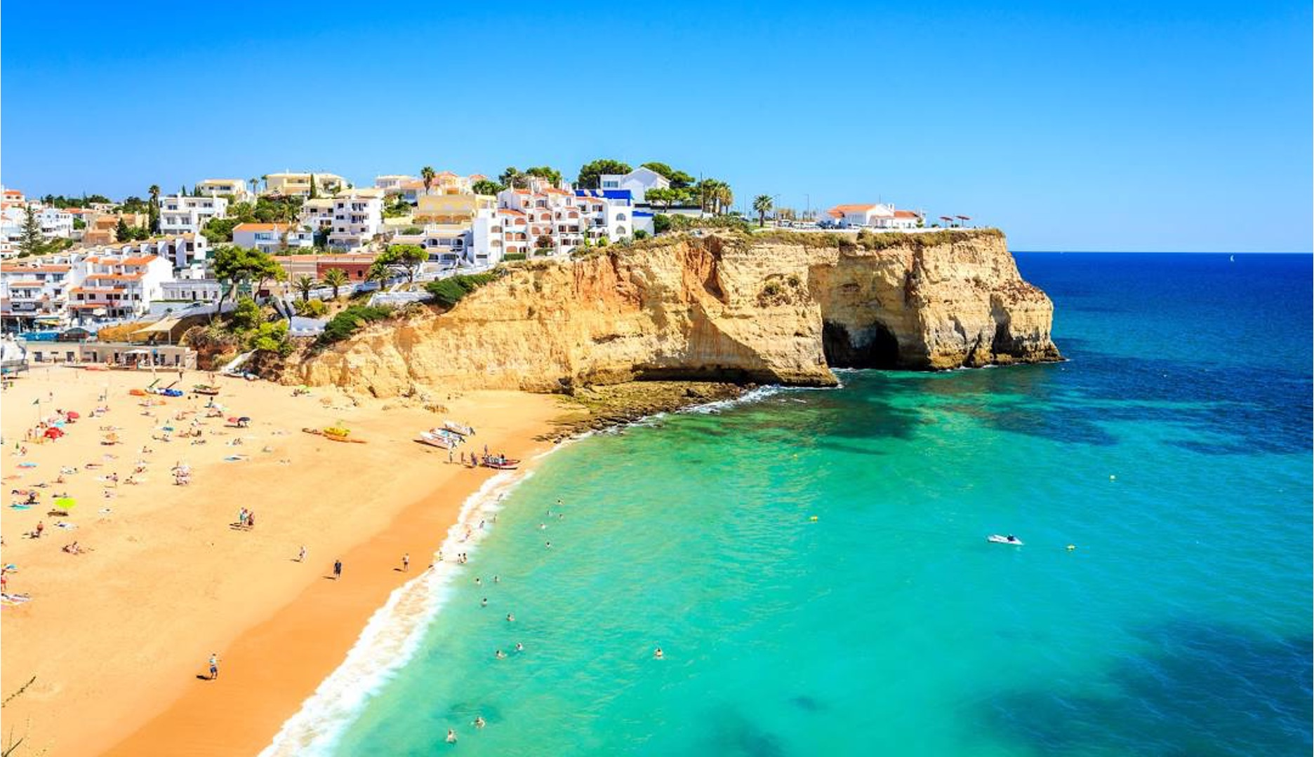
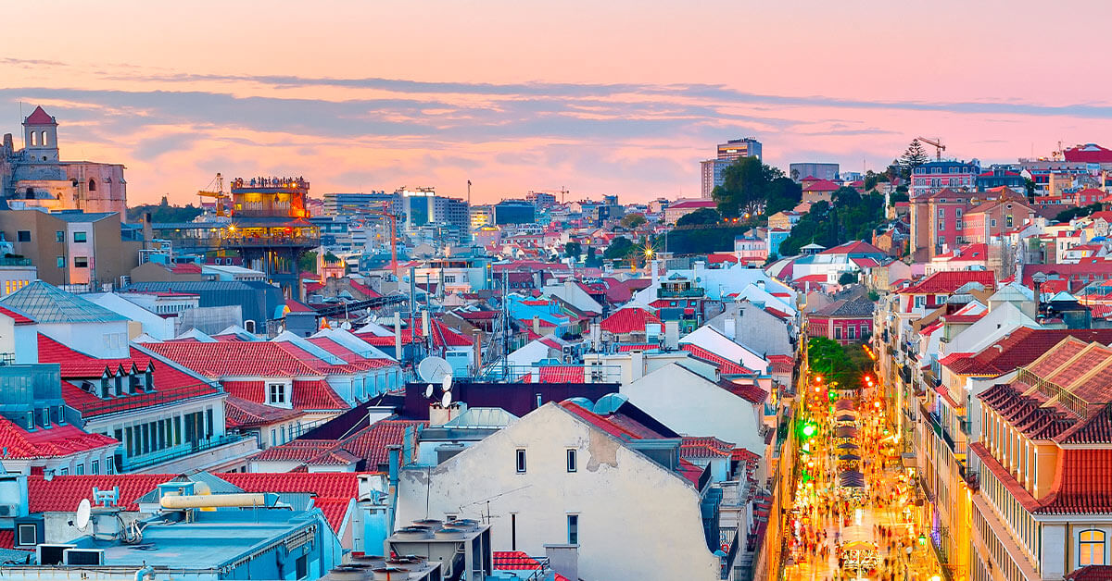
VAYCAME
Objectives
Reporters
Boarding
Lisbon, Portugal
Sign In
En
Jeronimo Monastery
03
08:00 Breakfast
09:00 Tour to Jeronimo Monastery
11:00 Pastéis de Belém(Egg tarts)
12:30 Lunch at Café do Forte
14:00 Belém Tower
16:00 Castelo de S. Jorge
19:30 Dinner at Wine and Books Hotel restaurant
Group 4 | PM 401
AWARD WINNING TOUT FOR ABC COMPANY TO LISBON, PORTUGAL
Text

Slide 21
VAYCAME
Objectives
Reporters
Boarding
Lisbon, Portugal
Sign In
En
04
Lisbon 1Day Tour
08:00 Breakfast
09:15 One day city
12:30 Lunch at A Taberna do Mar
15:45 Fado Museum
19:30 Fado dinner show at Povo
Group 4 | PM 401
AWARD WINNING TOUT FOR ABC COMPANY TO LISBON, PORTUGAL
TEXT

Slide 22
VAYCAME
Objectives
Reporters
Boarding
Lisbon, Portugal
Sign In
En
05
Cabo da Roca
07:00 Breakfast
08:00 Cabo da Roca Trip
12:00 Lunch at Bacalhau na Vila
14:00 Quinta da Regaleira
16:00 National Palace of Pena
19:00 Dinner at Churasqueira do Marques
Group 4 | PM 401
AWARD WINNING TOUT FOR ABC COMPANY TO LISBON, PORTUGAL
Text

Slide 23
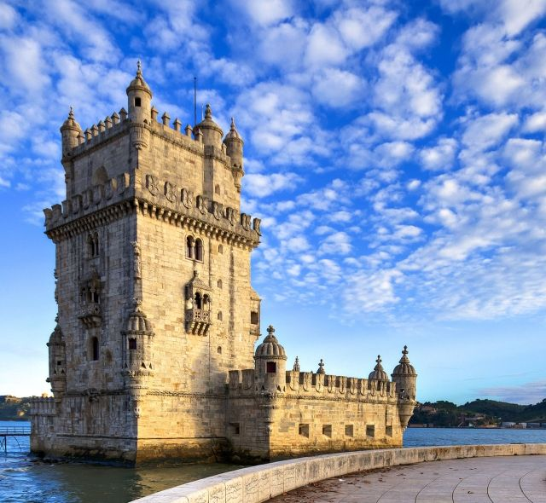
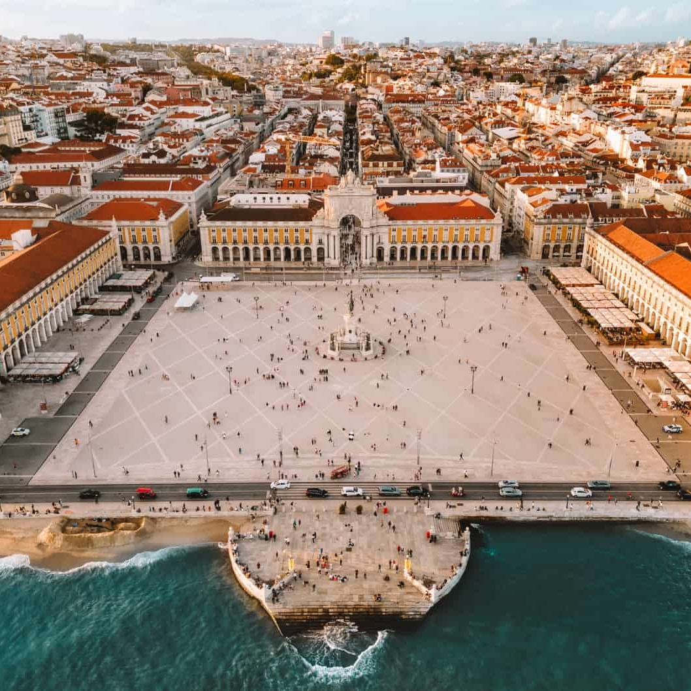
VAYCAME
Objectives
Reporters
Boarding
Lisbon, Portugal
Sign In
En
06
Algarve
06:30 Breakfast
08:00 Algarve tour
13:00 Lunch at Maria do Mar
19:45 Dinner at Mestrias, Nova Tasca
Group 4 | PM 401
AWARD WINNING TOUT FOR ABC COMPANY TO LISBON, PORTUGAL
Text

Slide 24
VAYCAME
Objectives
Reporters
Boarding
Lisbon, Portugal
Sign In
En
07
FREE DAY
Enjoy the relaxing time, shopping, or swimming
Group 4 | PM 401
AWARD WINNING TOUT FOR ABC COMPANY TO LISBON, PORTUGAL
Text

Slide 25
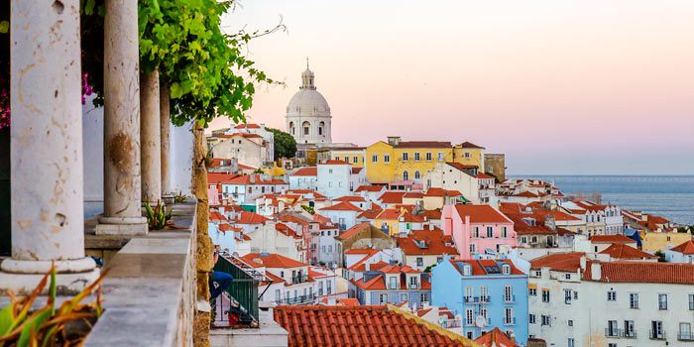
VAYCAME
Objectives
Reporters
Boarding
Search
Sign In
En
08
06:30 Breakfast Box in the bus
08:00 Check-in
10:05 Flight on AC 2709
15:55 Arrive at Vancouver
Lisbon, Protugal

Slide 26
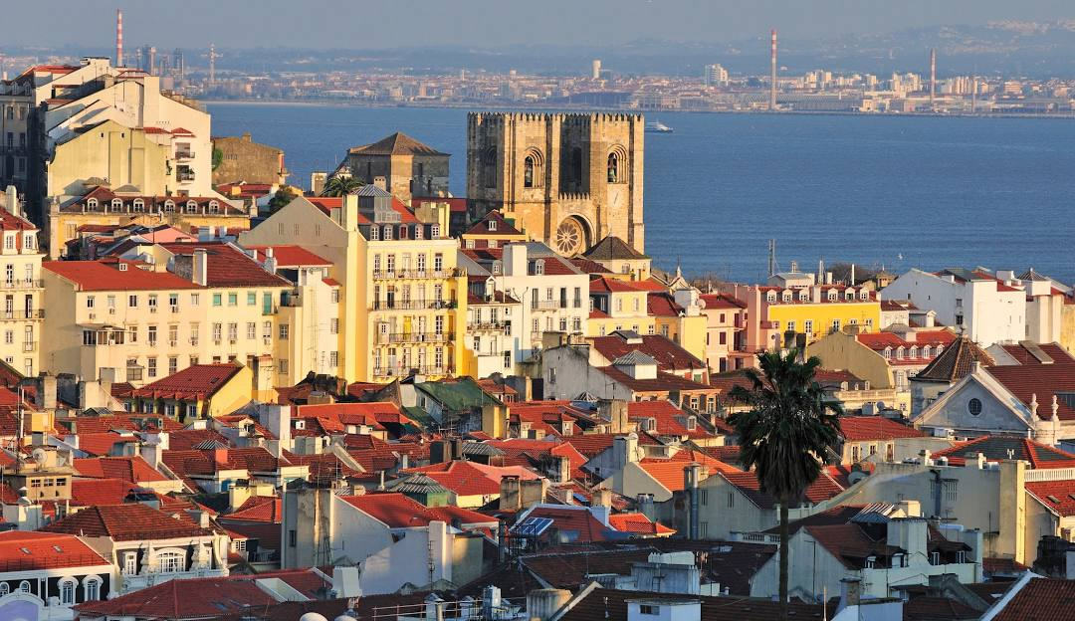
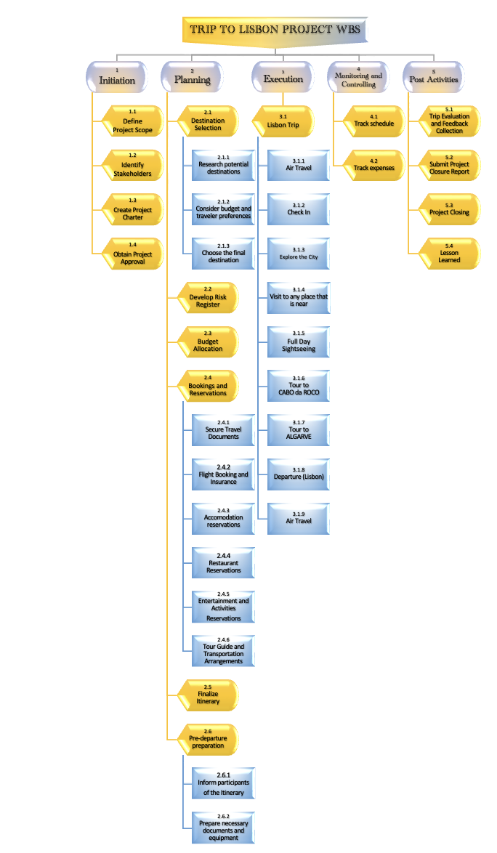
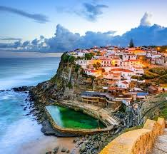
WBS

Slide 27
Initiation
Define Project Scope
Identify Stakeholders
Define Project Charter
Obtain Approval
WBS

Slide 28
Planning
Book airline
Book Hotel
Book attractions
Book local logistics
Finalize Itinerary
Itinerary handout
Legal document
Travel insurance
WBS

Slide 29
Execution
Air Travel
Half-day tour
Jeronimo Monastery
Full day city tour
Cabo da Roca
Algarve
Free day
Air Travel
WBS

Slide 30
Post Activitie
Feedback collection
Evaluation
Create Final report
Send out the report
Close project
Lesson learned
WBS

Slide 31
Guide Trouble | Relationship trouble with participants
Tight Schedule | Too tight schedule
Luggage Handling | Luggage damage or lost
Reputational Risk | Bad reputation and reviews
Food Poisoning | Food poisoning at a local restaurant or street vendors
RISK MANAGEMENT

Slide 32
Guide Trouble | Relationship trouble with participants
Tight Schedule | Too tight schedule
Luggage Handling | Luggage damage or lost
Reputational Risk | Bad reputation and reviews
Food Poisoning | Food poisoning at a local restaurant or street vendors
Cost Breakdown Structure
Actual Cost (Total Budget Cost): (29,756.59)
Contingency: CAD 6,000
Total Budget: CAD $35,756.59

Slide 33
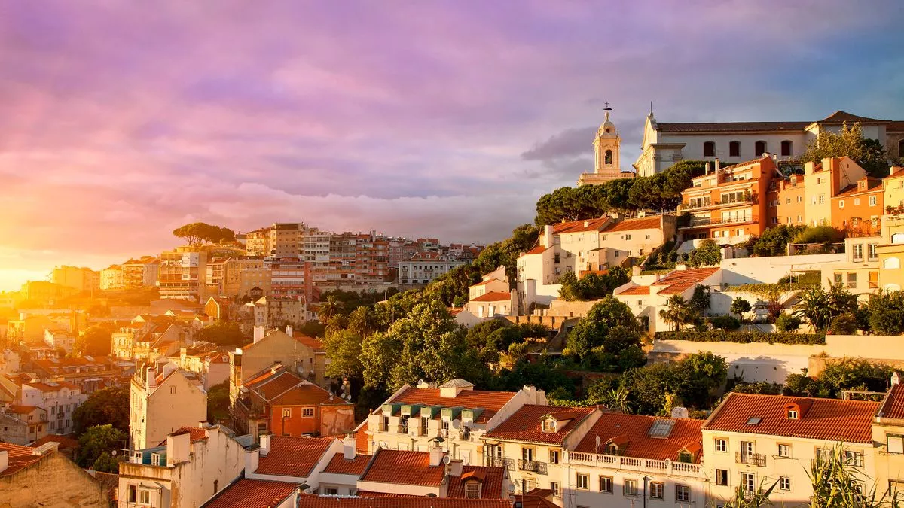
Total Tour Cost: C$29,756.59 exclude the contingency
Total Project Cost: C$35,756.59
Meals:
Breakfast at the Hotel
Lunch and Dinner at local Restaurant
Total: C$1,800
Accommodations:
Wine & Book Hotel with Breakfast – C$336/Night
(6 Participants at 7 night)
Total: C$7,056
Flights:
Flight Ticket – C$2,400/person (6 Participants)
Total: C$14,400
Transportation & Guide:
Transportation with a local Guide for 7 Days – C$2,100
Total: C$2,100
Algarve Day Trip:
Cost for 1 DAY Tour to Algarve- C$490/person (6 Participants)
Total: C$2,940
Admission Fees: Total: C$1460

Slide 34
Lisbon, Portugal Pie Chart: Percentage Distribution of All the Total Project Cost

Slide 35
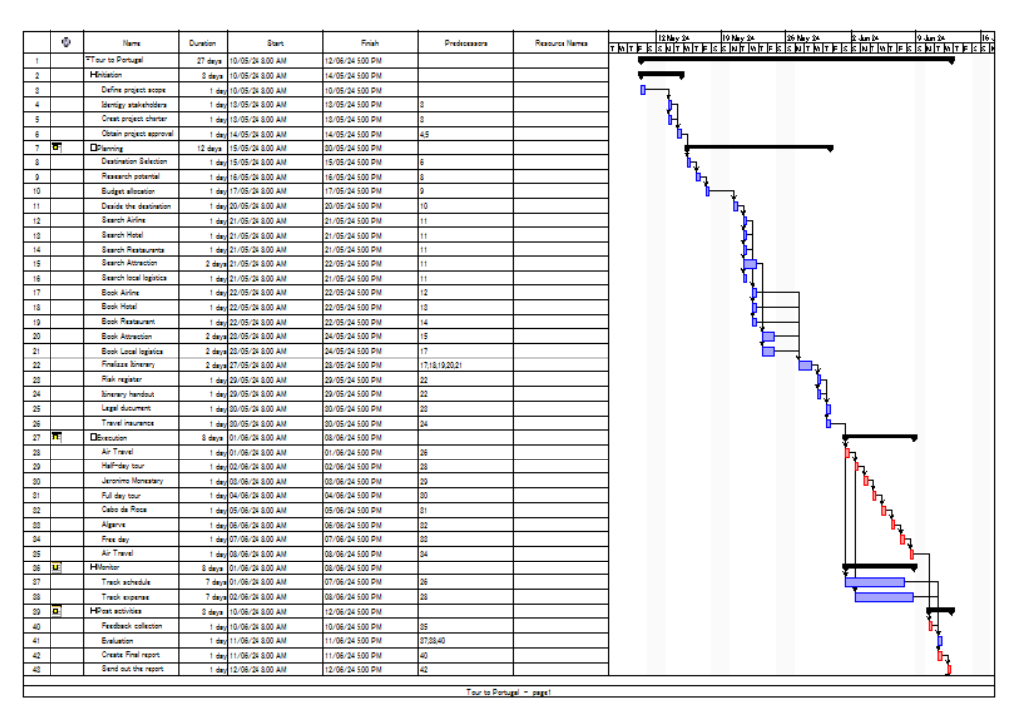
VAYCAME
Objectives
Reporters
Boarding
Lisbon, Portugal
Sign In
En
GANTT CHART

Slide 36
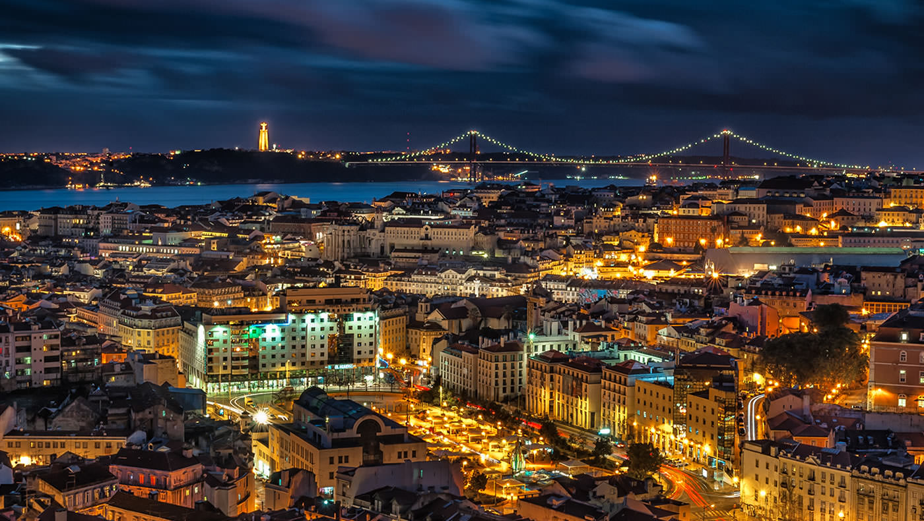
Reference
Reference:
Air Canada. (n.d.). Flight Booking. Retrieved from.https://www.aircanada.com/ca/en/aco/home/app.html?gclid=CjwKCAiAt5euBhB9EiwAdkXWO5DQ9i7_LPvVXQLJkxBu11Y3lBIGV5Z1Nrsh8KNwiKTgSYYoPoN4wRoCbmAQAvD_BwE#/faredriven.
Bing Videos. (n.d.). Praça do Comércio, Lisbon. Retrieved from.https://www.bing.com/videos/search?q=praca+do+comercio+lisboa&qpvt=praca+do+comercio+lisboa&FORM=VDRE.
Lisbon Portugal Tourism. (n.d.). Avenida da Liberdade. Retrieved from https://www.lisbonportugaltourism.com/guide/avenida-da-liberdade.html.
Lisbon Portugal Tourism. (n.d.). Rossio Square. Retrieved from.https://www.lisbonportugaltourism.com/guide/rossio-square.html.
Lisbon Wines, Books & Hotels. (n.d.). Retrieved from. https://lisboa.winebookshotels.com/.
Museu do Fado. (n.d.). Retrieved from .https://museudofado.pt/.
Pasteis de Belém. (n.d.). Retrieved from. https://pasteisdebelem.pt/en/.
São Jorge Castle. (n.d.). Retrieved from.https://castelodesaojorge.pt/en/.
Wikipedia. (n.d.). Jerónimos Monastery. Retrieved from. https://en.wikipedia.org/wiki/Jer%C3%B3nimos_Monastery.
Wikipedia. (n.d.). Rua Augusta Arch. Retrieved from. https://en.wikipedia.org/wiki/Rua_Augusta_Arch.
Text

Slide 37
VAYCAME
Objectives
Reporters
Boarding
Lisbon, Portugal
Sign In
En
THANK YOU
AWARD WINNIGNG TOUR FOR ABC COMPANY TO LISBON, PORTUGAL

